Slide 1
The Dual Problem: Minimization with problem constraints of the form ≥
Linear programming problems exist in pairs. That is in linear programming problem, every maximization problem is associated with a minimization problem. Conversely, associated with every minimization problem is a maximization problem. Once we have a problem with its objective function as maximization, we can write by using duality relationship of linear programming problems, its minimization version. The original linear programming problem is known as primal problem, and the derived problem is known as dual problem.

Slide 2
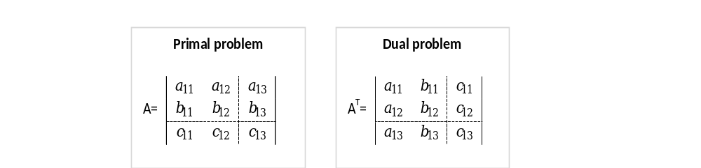
Thus, the dual problem uses exactly the same parameters as the primal problem, but in different locations. To highlight the comparison, now look at these same two problems in matrix notation.
Primal Problem |  |  | Dual Problem
Minimize | Z=cx |  | Maximize | W=yb
Subject to | Ax≥b |  | Subject to | yA≤c
and | x≥0 |  | And | y≥0

Slide 3
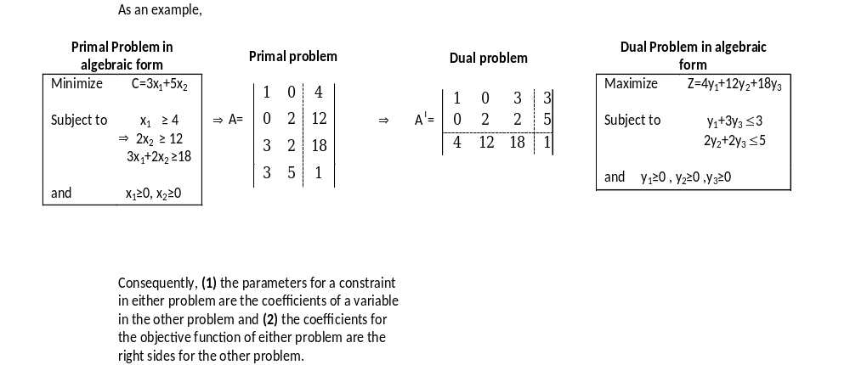

Slide 4
Summary
Primal | Dual
(a) Maximize. | Minimize
(b) Objective Function. | Right hand side.
(c) Right hand side. | Objective function.
(d) i th row of input-output coefficients. | i th column of input output coefficients.
(e) j th column of input-output coefficients. | j the row of input-output coefficients.

Slide 5
EXAMPLE 1
The procedure for forming the dual problem is summarized in the box below:
Formation of the Dual Problem
Given a minimization problem with problem constraints,
Step 1. Use the coefficients and constants in the problem constraints and the objective function to form a matrix A with the coefficients of the objec­tive function in the last row.
Step 2. Interchange the rows and columns of matrix A to form the matrix A^{T}, the transpose of A.
Step 3. Use the rows of A^{T} to form a maximization problem with ≤ problem constraints.
Forming the Dual Problem
Minimize C = 40x₁ + 12x₂ + 40x₃
subject to 2x₁ + x₂ + 5x₃ ≥ 20
4x₁ + x₂ + x₃ ≥ 30
x₁, x₂, X₃ ≥ 0

Slide 6
EXAMPLE 2
Form the dual problem:
Minimize C = 16 x₁ + 9x₂ + 21x₃
subject to x₁ + x₂ + 3x₃ ≥ 12
2x₁ + x₂ +x₃ ≥ 16
x₁, x₂, x₃ ≥ 0

Slide 7
EXAMPLE 3
Solution of Minimization Problems
ORIGINAL PROBLEM (1) Minimize C = 16x₁ + 45x₂ | DUAL PROBLEM (2) Maximize P = 50y₁ + 27y₂
subject to 2x₁ + 5x₂ ≥ 50 x₁ + 3x₂ ≥ 27 x₁, x₂ ≥ 0 | subject to 2y₁ + y₂ ≤ 16 5y₁ + 3y₂ ≤ 45 y₁,y₂ ≥ 0

Slide 8
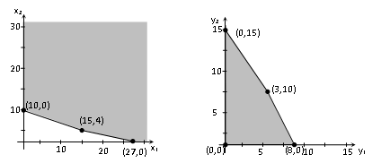
Corner Point |  |  | Corner Point
(x₁, x₂) | C= 16x₁+45 x₂ |  | (y₁, y₂) | P=50y₁+27 y₂
(0,10) | 450 |  | (0,0) | 0
(15,4) | 420 |  | (0,15) | 405
(27,0) | 432 |  | (3,10) | 420
 |  |  | (8,0) | 400
Min C=420 at (15,4) |  |  | Max P=420 at (3,10)

Slide 9
For reasons that will become clear later, we will use the variables x₁ and x₂ from the original problem as the slack variables in the dual problem:
2y₁ + y₂ + x₁ =16 (initial system for the dual problem)
5y₁ + 3y₂ + x₂ =45
-50y₁- 27y₂ + P =0

Slide 10
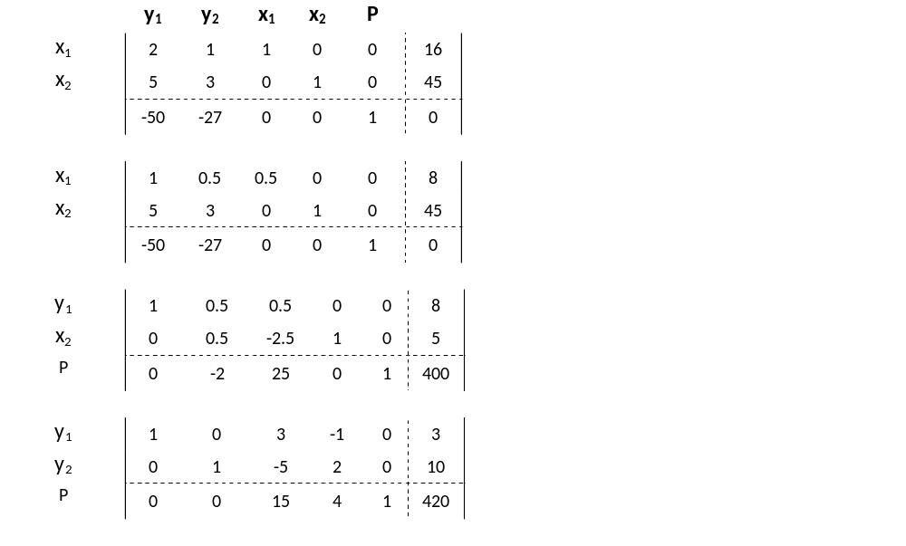

Slide 11
Since all indicators in the bottom row are nonnegative, the solution to the dual problem is
y₁ = 3, y₂ = 10, x₁ = 0, x₂ = 0, P = 420
which agrees with our earlier geometric solution. Furthermore, examining the bot­tom row of the final simplex tableau, we see the same optimal solution to the mini­mization problem that we obtained directly by the geometric method:
Min C = 420 at x₁ = 15, x₂ = 4
This is not achieved with mistake.
An optimal solution to a minimization problem always can be obtained from the bottom row of the final simplex tableau for the dual problem.
Now we can see that using x₁ and x₂ as slack variables in the dual problem makes it easy to identify the solution of the original problem.

Slide 12
EXAMPLE 4
Solve the following minimization problem by maximizing the dual:
Minimize C = 40x₁ + 12x₂ + 40x₃
subject to 2x₁ +x₂ + 5x₃ ≥ 20
4x₁ + x₂ + x₃ ≥ 30
Nonnegativity
x₁, x₂, x₃ ≥ 0

Slide 13
Maximization and minimization with mixed problem constraints
In this section we present a generalized version of the simplex method that will solve both maximization and minimization problems with any combination of ≤, ≥, and = problem constraints.
When the constraint is in the form of ≤ we introduce slack variable (unused capacity), and when the constraint is in the form of ≥ we subtract the surplus (excess amount).

Slide 14
In order to use the simplex method on problems with mixed constraints, we turn to an ingenious device called an artificial variable. This variable has no physical meaning in the original problem (which explains the use of the word "artificial") and is introduced solely for the purpose of obtaining a basic feasible solution so that we can apply the simplex method. An artificial variable is a variable introduced into each equation that has a surplus variable. As before, to ensure that we consider only basic feasible solutions, an artificial variable is required to satisfy the nonnegative constraint.

Slide 15
To prevent an artificial variable from becoming part of an optimal solution to the original problem, a very large "penalty" is introduced into the objective function. This penalty is created by choosing a positive constant M so large that the artificial variable is forced to be 0 in any final optimal solution of the original problem.

Slide 16
Big M Method: Introducing Slack, Surplus, and Artificial Variables to Form the Modified Problem
Step 1. If any problem constraints have negative constants on the right side, multiply both sides by -1 to obtain a constraint with a nonnegative con­stant. (If the constraint is an inequality, this will reverse the direction of the inequality.)
Step 2. Introduce a slack variable (S) in each ≤ constraint.
Step 3. Introduce a surplus variable (E) and an artificial variable (A) in each ≥ constraint.
Step 4. Introduce an artificial variable (A) in each = constraint.
Step 5. For each artificial variable A_{i} subtract- MA_{i} from the objective function.

Slide 17
EXAMPLE 5
Find the modified problem for the following linear programming problem. (Do not attempt to solve the problem.)
Maximize P = 2x₁ + 5x₂ + 3x₃
subject to x₁ + 2x₂ - x₃ ≤ 7
-x₁ + x₂ - 2x₃ ≤-5
x₁ + 4x₂ + 3x₃ ≥ 1
2x₁- x₂ + 4x₃ = 6
x₁, x₂, x₃ ≥ 0

Slide 18
SOLUTION
First, we multiply the second constraint by -1 to change -5 to 5:
(-1)(-x₁ + x₂ -2x₃ ) ≥ (-1)(-5) ⇒ x₁ - x₂ + 2x₃ ≥ 5
Next, we introduce the slack, surplus, and artificial variables according to the proce­dure stated in the box:
x₁ + 2x₂ - x₃ +S₁ = 7
x₁ - x₂ + 2x₃ -E₁+A₁ = 5
x₁ + 4x₂ + 3x₃ -E₂+A₂ =1
2x₁- x₂ + 4x₃ +A₃ = 6

Slide 19
Finally, we subtract MA₁, MA₂, and MA₃ from the objective function to penalize the artificial variables:
P = 2x₁ + 5x₂ + 3x₃ - MA₁ - MA₂ - MA₃
The modified problem is
Maximize P = 2x₁ + 5x₂ + 3x₃ - MA₁ - MA₂ - MA₃
subject to x₁ + 2x₂ - x₃ +S₁ = 7
x₁ - x₂ + 2x₃ -E₁+A₁ = 5
x₁ + 4x₂ + 3x₃ –E₂+A₂ =1
2x₁- x₂ + 4x₃ +A₃ = 6
x₁, x₂, x₃, S₁, E₁, E₂, A₁, A₂, A₃ ≥ 0

Slide 20
After introducing the slack, surplus and artificial variables we continue to solve the problem with following steps;
Step 1. Form the preliminary simplex tableau for the modified problem.
Step 2. Use row operations to eliminate the M’s in the bottom row of the prelim­inary simplex tableau in the columns corresponding to the artificial vari­ables. The resulting tableau is the initial simplex tableau.
Step 3. Solve the modified problem by applying the simplex method to the initial simplex tableau found in step 2.

Slide 21
EXAMPLE 6
Solve the following linear programming problem using the big M method:
Maximize P = x₁ - x₂ + 3x₃
subject to x₁ + x₂ ≤ 20
x₁ + x₃ = 5
x₂ + x₃ ≥ 10
x₁ , x₂, x₃ ≥ 0

Slide 22
Minimization by the big M method
In addition to solving any maximization problem, the big M method can be used to solve minimization problems. To minimize an objective function, we have only to maximize its negative. Further­more, if M is the minimum value of f, then —M is the maximum value of -f, and conversely. Thus, we can find the minimum value of a function f by finding the max­imum value of -f and then changing the sign of the maximum value.

Slide 23
EXAMPLE 7
Production Scheduling: Minimization Problem A small jewelry manufac­turing company employs a person who is a highly skilled gem cutter, and it wishes to use this person at least 6 hours per day for this purpose. On the other hand, the polishing facilities can be used in any amounts up to 10 hours per day. The company specializes in three kinds of semiprecious gemstones, J, K, and L. Relevant cutting, polishing, and cost requirements are listed in the table. How many gemstones of each type should be processed each day to minimize the cost of the finished stones? What is the minimum cost?
 | J | K | L
Cutting | 1hr | 1hr | 1hr
Polishing | 2hr | 1 hr | 2hr
Cost per stone | $30 | $30 | $10

